Slide 1
CMSC204
Kartchner
V(StateGraph) = {Oregon, Alaska, Texas, Hawaii, Vermont, NewYork, California}
E(StateGraph) = {(Alaska, Oregon), (Hawaii, Alaska), (Hawaii, Texas), (Texas, Hawaii), (Hawaii, California), (Hawaii, New York), (Texas, Vermont), (Vermont, California), (Vermont, Alaska)}
1. Draw the StateGraph
New York
Hawaii
Oregon
Texas
California
Alaska
Vermont

Slide 2
a. Show the adjacency matrix that would describe the edges in the graph. Store the vertices in alphabetical order
States
Alaska
0 0 0 0 1 0 0
California
0 0 0 0 0 0 0
Hawaii
1 1 0 1 0 1 0
New York
0 0 0 0 0 0 0
Oregon
0 0 0 0 0 0 0
Texas
0 0 1 0 0 0 1
Vermont
1 1 0 0 0 0 0
3. b. Show the adjacency lists
that would describe the edges in the graph
Alaska
Oregon
California
Hawaii
Alaska
California
Alaska
NY
New York
Oregon
Texas
Vermont
Hawaii
Vermont
Alaska
California

Slide 3
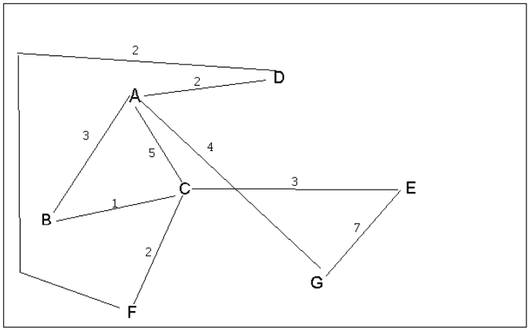
4 a. Which of the following lists the graph nodes in depth first order beginning with E?
A) E, G, F, C, D, B, A
B) G, A, E, C, B, F, D
C) E, G, A, D, F, C, B
D) E, C, F, B, A, D, G
4 b. Which of the following lists the graph nodes in breadth first order beginning at F?
A) F, C, D, A, B, E, G
B) F, D, C, A, B, C, G
C) F, C, D, B, G, A, E
D) a, b, and c are all breadth first traversals

Slide 4
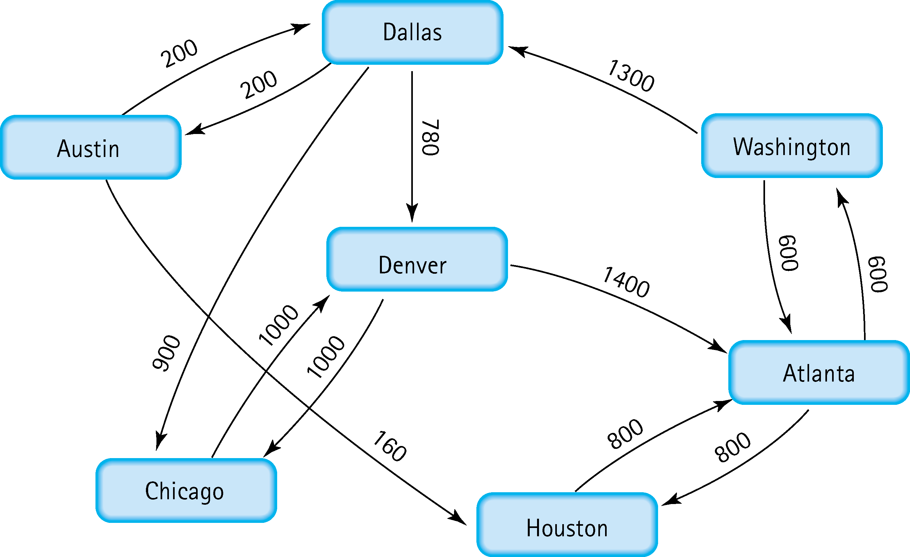
5. Find the shortest distance from Atlanta to every other city
Atlanta – Austin 600 + 1300 + 200 = 2100
Atlanta – Chicago 600 + 1300 + 900 = 2800
Atlanta – Dallas 600 + 1300 = 1900
Atlanta – Denver 600 + 1300 + 780 = 2680
Atlanta – Houston 800
Atlanta – Washington 600

Slide 5
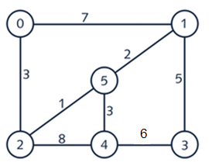
6. Find the minimal spanning tree using Prim’s algorithm. Use
0 as the source vertex . Show the steps.
0
0
5
2
2
0
1
0
1
5
5
2
2
4
0
1
5
2
4
3

Slide 6
7. Find the minimal spanning tree using Kruskal’s algorithm.
Show the weights in order and the steps.
2 – 5 : 1
1 – 5 : 2
0 – 2 : 3
4 – 5 : 3
1 – 3 : 5
3 – 4 : 6
0 – 1 : 7
2 – 4 : 8
0

Slide 7
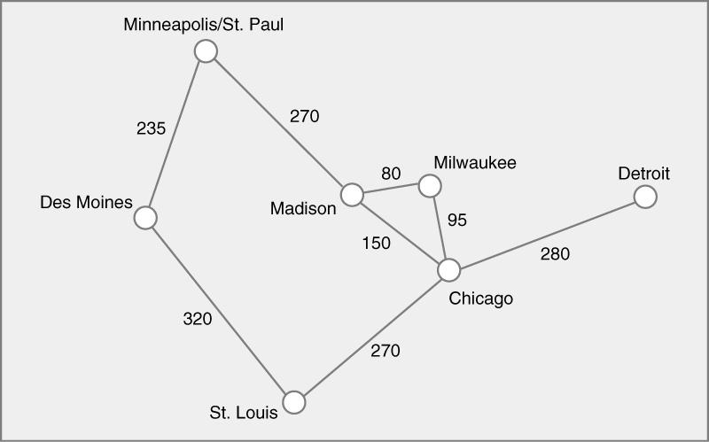
8. Find the minimal spanning tree using the algorithm you prefer. Use
Minneapolis/St. Paul as the source vertex
Using Kruskal’s:
Mad-Mil: 80
Mil-Chi: 95
Mad-Chi: 150
Min-Des: 235
Min-Mad: 270
Chi-StL: 270
Chi-Det: 280
Des-StL: 320

Slide 8
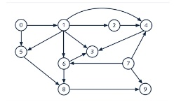
9. List the nodes of the graph in a breadth first topological ordering. Show the
steps using arrays predCount, topologicalOrder and a queue
[0]
[1]
[2]
[3]
[4]
[5]
[6]
[7]
[8]
[9]
predCount
0
1
1
3
3
2
2
0
2
2
[0]
[1]
[2]
[3]
[4]
[5]
[6]
[7]
[8]
[9]
topologicalOrder
queue
0, 7
[0]
[1]
[2]
[3]
[4]
[5]
[6]
[7]
[8]
[9]
predCount
0
0
1
3
3
1
2
0
2
2
[0]
[1]
[2]
[3]
[4]
[5]
[6]
[7]
[8]
[9]
topologicalOrder
0
queue
7 , 1

Slide 9
[0]
[1]
[2]
[3]
[4]
[5]
[6]
[7]
[8]
[9]
predCount
0
0
1
3
2
1
1
0
2
1
[0]
[1]
[2]
[3]
[4]
[5]
[6]
[7]
[8]
[9]
topologicalOrder
0
7
queue
1
[0]
[1]
[2]
[3]
[4]
[5]
[6]
[7]
[8]
[9]
predCount
0
0
0
2
1
0
0
0
2
1
[0]
[1]
[2]
[3]
[4]
[5]
[6]
[7]
[8]
[9]
topologicalOrder
0
7
1
queue
2, 5, 6
[0]
[1]
[2]
[3]
[4]
[5]
[6]
[7]
[8]
[9]
predCount
0
0
0
1
0
0
0
0
0
1
[0]
[1]
[2]
[3]
[4]
[5]
[6]
[7]
[8]
[9]
topologicalOrder
0
7
1
2
5
6
queue
4, 8

Slide 10
[0]
[1]
[2]
[3]
[4]
[5]
[6]
[7]
[8]
[9]
predCount
0
0
0
0
0
0
0
0
0
0
[0]
[1]
[2]
[3]
[4]
[5]
[6]
[7]
[8]
[9]
topologicalOrder
0
7
1
2
5
6
4
8
queue
3, 9
[0]
[1]
[2]
[3]
[4]
[5]
[6]
[7]
[8]
[9]
predCount
0
0
0
0
0
0
0
0
0
0
[0]
[1]
[2]
[3]
[4]
[5]
[6]
[7]
[8]
[9]
topologicalOrder
0
7
1
2
5
6
4
8
3
9
queue

Slide 11
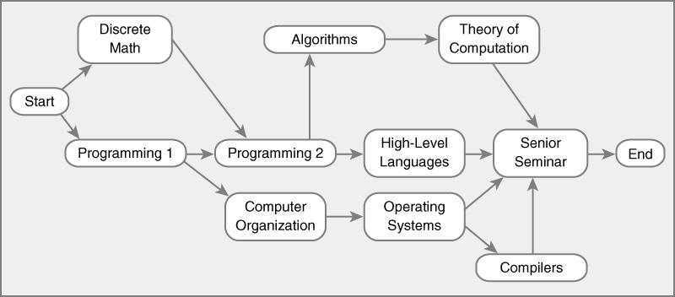
10. List the nodes of the graph in a breadth first topological ordering.
Start
Discrete Math
Programming 1
Computer Organization
Programming 2
Operating Systems
Algorithms
High-Level Languages
Compilers
Theory of Computation
Senior Seminar
End

